Slide 1
Module 4: Editing text
4: Editing text
5: Bash
6: Bash environment

Slide 2
Contents
Evolution of text editors
Using vi/vim
Nano
Notes:
Editing text is an essential skill we will learn about vi and nano in this chapter.

Slide 3
Evolution of text editors (Reference)

Slide 4


Before Unix or Linux – qed
qed – University of California at Berkeley (1966)
‘Quick editor’
Pronounced Q E D
Written by Butler Lampson and Peter Deutsch
For teleprinter, not screens
Q
E
D
E
D
E
X
V
I
V
I
M

Slide 5

ed
Pronounced ee dee (the two letters)
One of the first three elements of Unix
Developed by Ken Thompson on PDP-7, August 1969
Features:
Line based
Supports regular expressions
Commands can come from standard input
Almost no visual feedback
Q
E
D
E
D
E
X
V
I
V
I
M

Slide 6

ex
Pronounced ee ex (the two letters)
Designed as an extended version of ed
With visual feedback
Less resource intensive than the intermediary editor em
em was written by George Coulouris at QMC, London
ex created by Bill joy at Berkely, 1976
Was eventually given a full screen visual interface
Instigated by the command visual
This evolved into vi
Q
E
D
E
D
E
X
V
I
V
I
M

Slide 7
vi
Pronounced vee eye (the two letters)
Named after the ex command visual
Written by Bill joy to enhance ex
Original code in 1976
Released as vi in 1979
Many clones exist
Q
E
D
E
D
E
X
V
I
V
I
M

Slide 8

vim (vi clone)
A contraction of Vi IMproved
Written by Bram Moolenaar (1991)
Derived for a port of the editor stevie
ST Editor for Vi Enthusiast, Tim Thomson 1978
Features added by Tony Andrews and ported to amiga
This port was the starting point for VIM
Q
E
D
E
D
E
X
V
I
V
I
M

Slide 9
Using vi / vim

Slide 10
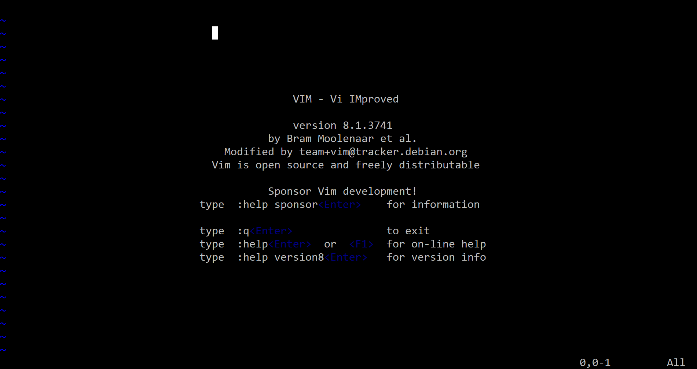
vi and vim
vi is a visual display-presentation editor.
Based on an underlying editor ex
Interface is unusual and difficult for newcomers.
The GPL version, provided on Linux, is called vim.
Typically invoked as:
vi file – fully functioning
view file - read-only
$ vi afilename
$ view afilename

Slide 11
Modes of operation
$ vi afilename
$
ZZ
Command
Mode
(the keys do things)
x q wq q!
i I a A o O C
<cr>
<esc>
ex Mode
(ex’s
line-editor commands)
Insert
Mode
(the keys type things)
:
Notes:
Initially vi starts in command mode; in this mode the keys pressed do things rather than write text.
Some of the keys (iIaAoOc) will cause the mode to change to insert; in this mode keys typed will produce text.
Insert mode itself will push subsequent text out of the way as it inserts; to come out of Insert mode press the escape key.
While in command mode, pressing will cause the cursor to move bottom left, entering ex mode.
This mode allows the use of ex commands.

Slide 12
Command mode
Default on entry
Basic vi command format
[Count]Command[Scope]
For example: 10dw
Means delete 10 words (10 * delete word)
Some commands place vi into insert. mode
Press <ESC>To return to command mode.
When in ex mode you will need to enter.
Press <CR> to execute the command.
<CR> on its own will simply return to command mode.
10dw
Command
Mode
(the keys do things)
Notes:
Command mode is the mode on entry to vi.
Commands are usually single letters, but prefixed counts can be used to repeat a count an arbitrary number of times.
Some commands (such as colon to enter ex mode) expect an argument to be typed in, and are terminated with the enter key.

Slide 13
Moving the cursor a character
Key combinations that move the cursor one character include:
Keys | Action
h | Left cursor move
l | Right cursor move
k | Up cursor move
j | Down cursor move
h j k l
Command
Mode
(the keys do things)
Notes:
In VIM the cursor keys work (providing noncompatible is set), mostly negating the use of noncompatible, and l.

Slide 14
Moving the cursor – Words
Key combinations that move the cursor by line include:
Keys | Action
w | Forward to start of next word
b | Backwards to start of word
e | Forward to end of word
Command
Mode
(the keys do things)
Notes:
In VIM the cursor keys work (providing noncompatible is set), mostly negating the use of noncompatible, and l.

Slide 15
Moving the cursor – Lines
Key combinations that move the cursor by line include:
Keys | Action
0 | Start of this line
$ | End of this line
nG | Go to line n
G | Go to last line
gg | Go to first line
} | End of paragraph
{ | Beginning of paragraph
Command
Mode
(the keys do things)
Notes:
In VIM the cursor keys work (providing noncompatible is set), mostly negating the use of noncompatible, and l.

Slide 16
Moving the cursor – Control (keys)
Control keys that effect vi display include:
Key | Action
^F | Forward one screen
^B | Back one screen
^D | Down half a screen
^U | Up half a screen
^G | Print line number and other status info
^L | Redraw the screen
Command
Mode
(the keys do things)

Slide 17
Inserting new text
Each of these commands puts vi into insert mode;
Text is inserted into the file until <ESC> is pressed (or ^[), returns it to command mode.
Within insert mode the backspace and delete keys work.
To ensure vi shows which mode you: are in
:set showmode
Key | Action
i | Insert before cursor
a | Append after cursor
I | Insert at start of line
A | Append at end of line
o | Open new line below this one
o | Open new line below this one
Command
Mode
(the keys do things)
Insert
Mode
(the keys type things)
<esc>
Notes:
Before using vi it is definitely worth switching on showmode using the ex mode command
:set showmode
This can be achieved in advance by either setting an (1) environment variable or (2) using an initialization file
export EXINIT=‘set showmode’
Create a file in your home directory called .vimrc (for vim) with the ex mode commands within it.
Also set noncompatible if you wish to use the cursor keys within insert mode.

Slide 18
Replacing text
Keys | Action
r | Replace character under cursor (type character after r)
R | Enter replace mode (overstrike)
Command
Mode
(the keys do things)
Notes:
The change command also operates on a “scope”.
When doubled up, the c (change) command applies to whole lines.
Thus, cc will change one line and 10cc will change 10 lines.
Change saves the changed lines in the paste buffer.

Slide 19
Delete / cut character
Keys | Action
x | Delete character under cursor (delete)
X | Delete character to left of cursor (backspace)
Command
Mode
(the keys do things)
Notes:
Deleting text does a cut (as in cut and paste) the selected characters.
The delete command operates on a so-called “scope”, which describes an object to be operated on.
When doubled up, the d (delete) command applies to whole lines.
Thus, dd will delete one line and 10dd will delete 10 lines.
delete saves the removed text in the paste buffer. It can be retrieved by using the p or P commands (providing no other text has been changed).
vi remembers nine deletions, each of which can be brought back individually.

Slide 20
Changing text
Keys | Action
c<scope> | Change text, specifying size (scope) of change
cw | Change to end of word
ncw | Change to end of nth word
c3l | Change the next three characters
c0 | Change to the beginning of the line
c$ or C | Change to end of the line
c1G or cgg | Change to the beginning of the file
cG | Change to end of the file
cc | Change current line
ncc | Change n lines
Command
Mode
(the keys do things)
Notes:
The change command also operates on a “scope”.
When doubled up, the c (change) command applies to whole lines.
Thus, cc will change one line and 10cc will change 10 lines.
Change saves the changed lines in the paste buffer.

Slide 21
Delete / cut text
Keys | Action
d<scope> | Delete/cut to buffer specifying size (scope) of change
dw | Delete to end of word
ndw | Delete to end of nth word
d3l | Delete the next three characters
d0 | Delete to the beginning of the line
d$ or D | Delete to end of the line
d1G or dgg | Delete to the beginning of the file
dG | Delete to end of the file
dd | Delete current line into buffer
ndd | Delete n lines into buffer
Command
Mode
(the keys do things)
Notes:
Deleting text does a cut (as in cut and paste) the selected characters.
The delete command operates on a so-called “scope”, which describes an object to be operated on.
When doubled up, the d (delete) command applies to whole lines.
Thus, dd will delete one line and 10dd will delete 10 lines.
delete saves the removed text in the paste buffer. It can be retrieved by using the p or P commands (providing no other text has been changed).
vi remembers nine deletions, each of which can be brought back individually.

Slide 22
Yanking (copying) and pasting text
Keys | Action
y<scope> | Yank/copy to buffer specifying size (scope) of change
yw | Yank to end of word
nyw | Yank to end of nth word
y3l | Yank the next three characters
y0 | Yank to the beginning of the line
y$ | Yank to end of the line
y1G or ygg | Yank to the beginning of the file
yG | Yank to end of the file
yy | Yank current line into buffer
nyy | Yank n lines into buffer
p | Paste current buffer after current position
P | Paste current buffer before current position
Command
Mode
(the keys do things)
Notes:
Because c is change, y (yank) is like delete in that it puts text into the buffer, but the original text remains.

Slide 23

Search for text
Keys | Action
/pattern | Search forward for pattern (regular expression)
?pattern | Search backwards (regular expression)
/ | Repeat last search forwards
? | Repeat last search backwards
n | Repeat last search in same direction (next)
N | Repeat last search in opposite direction (next)
Command
Mode
(the keys do things)
Notes:
To get best use learn regular expressions (RE).
It is possible to search forwards or backwards for particular text in vi.
Search and replace needs to be done in the ex mode, so the “:” command is necessary.
:5,10s/hello/goodbye/
The above example replaces the first occurrence of “hello” for “goodbye” on each of lines 5 through 10.
:1,$s/goodbye/Goodbye/gc
The above example will capitalise all occurrences of “goodbye” in the file (from first to last line, multiple times per line), but only after confirmation.

Slide 24
Tagging lines
Keys | Action
m<letter> | Mark this line (case sensitive)
‘<letter> | Go to the beginning of the line marked with this letter
d’<letter> | Delete to the beginning of the line marked with this letter
y’<letter> | Yank to the beginning of the line marked with this letter
Command
Mode
(the keys do things)
Notes:
Marking a command allows you to tag any line with a unique letter.
That tag can be used later either for moving purposes, or indeed as a "scope" definition for other commands.

Slide 25
Miscellaneous
Keys | Action
. | Repeat last edit command
u | Undo last edit command
U | Undo all changes to current line
J | Join the next line onto the end of this one
~ | Invert case and move right
yyp or yyP | Duplicate this line
xp | Swap this and the next character around
ZZ | Save and exit file
Command
Mode
(the keys do things)
Notes:
The "undo" commands are most useful when something goes wrong.
Remember to hit the <ESC> key before using u or U.
The U command will not work if the line has been deleted.

Slide 26
ex mode
ex is a line editor
In vi the ex-commands start with a :
Cursor moves to bottom left
Acts on current line
Unless command syntax specifies line(s) to act upon
Also used to set vi options
<CR> returns to command mode
Immediately after the colon
At the end of the command line, after command has completed/aborted.
Command
Mode
(the keys do things)
<cr>
ex Mode
(ex’s line-editor commands)
:

Slide 27
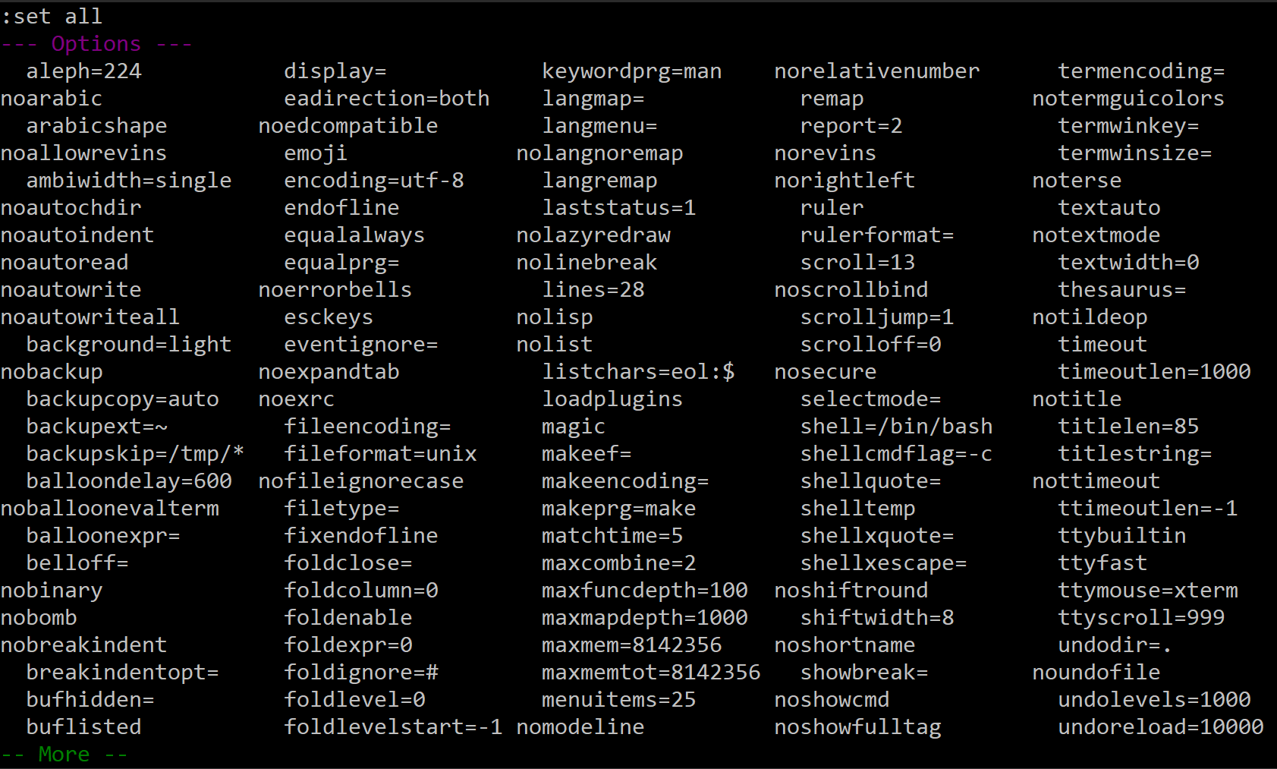
Setting options
ex command | Action
:set all | Shows all options (paginated), q to exit
:set option | Switches option on
:set nooption | Switches option off
:set number | Switches line-numbers on
:set nonumber | Switches line-numbers off
ex Mode
(ex’s line-editor commands)
Notes:
In the list of options, those starting with “no” are currently switched off.
Typing :set option within an existing vi session modifies that option temporarily.
In order to permanently change option setting we can either create an EXINIT variable (which is checked by vi every time it starts) or modify the .exrc file in your home directory, which is also consulted on every start-up of vi.
The .exrc file is one of the earliest Unix start-up files ever, and the name is a strong indicative of this.
Originally, this file was used to configure the ex editor, later vi.
Technically speaking it is still available in Linux, but since vi is being pushed out by vim, the configuration is changing too.
Consequently, in contemporary Linux distributions the .exrc file is being abandoned in preference of the .vimrc file, either in the user’s home directory (in which case settings apply to that user only) or in the /etc directory for system-wide use.

Slide 28
Specifying the line(s) commands act upon
Single line
Ranges
ex command | Action
:ncommand | Execute command on line n
:1command | Execute command on the first line
:$command | Execute command on the last line
ex command | Action
:n,mcommand | Execute command on lines n to m (inclusively)
:1,$command | Execute command on all lines
:/RE1/,/RE2/command | Execute command starting with the line matching RE1 to the line matching RE2 (inclusively)
ex Mode
(ex’s line-editor commands)
Notes:
Line numbers can be specified by number, $ (last line) or RE (regular expression).
Ranges are two of these with a comma between.

Slide 29
Replace text (one line)
ex mode replace
(RE = Regular expression –> a pattern)
ex command | Action
:s/RE/new/ | Replace first occurrence of RE with new on this line
:5s/RE/new/ | Replace first occurrence of RE with new on line 5
:50s/RE/new/g | Replace all occurrences of RE with new on line 50
:20s/RE/new/gc | Replace all occurrences of RE with new on line 50 confirming each change
ex Mode
(ex’s line-editor commands)
Notes:
There will be a notification at the bottom of the screen announcing how many changes made.

Slide 30
Replace text (all lines)
ex mode replace
Note: For any other range replace 1,$ with the required range. Examples follow.
ex command | Action
:1,$s/RE/new/ | Replace first occurrence of RE with new on all lines
:1,$s/RE/new/g | Replace all occurrences of RE with new on all lines
:1,$s/RE/new/gc | Replace all occurrences of RE with new on all lines confirming each change
ex Mode
(ex’s line-editor commands)
Notes:
There will be a notification at the bottom of the screen announcing how many changes made.

Slide 31
Replace text (ranges)
ex mode replace
ex command | Action
:14,20s/RE/new/ | Starting from the line 14 ending at the line 20 replace all occurrences of RE with new
:/RE1/,/RE2/s/RE3/new/g | Starting from the line matching RE1 ending at the line matching RE2 replace all occurrences of RE3 with new
:20,/RE1/s/RE2/new/g | Starting from the line 20 ending at the line matching RE1 replace all occurrences of RE2 with new
ex Mode
(ex’s line-editor commands)
Notes:
There will be a notification at the bottom of the screen announcing how many changes made.

Slide 32
Reading from
Reading in
ex command | Action
:r file | Read contents of a file called file and place it after current line
:!command | Execute the shell-command command showing results (<CR> to return)
:r!command | Execute the shell-command placing its output after the current line
ex Mode
(ex’s line-editor commands)

Slide 33
Writing to files
Writing to a file
ex command | Action
:w | Write (save) to the current file
:w! | Write (save) to the current file, overriding protection
:w file | Write (save as) to file called file
:n,mw file | Write (save as) the range of text specified to file called file
ex Mode
(ex’s line-editor commands)

Slide 34
Leaving the editor
Leaving vi
ex command | Action
:q | Quit (if no changes have been made since entering or last save)
:q! | Force quit (loosing changes)
:x | Save to current file (if needed) and quit
:wq | Save to current file (if needed) and then quit
ex Mode
(ex’s line-editor commands)

Slide 35
Buffers
Editing multiple files
ex command | Action
:buffers :ls | List currently available buffers
:e filename | Edit file in new buffer (need to save previous first)
:bp | Use previous buffer
:bn | Use next buffer
:b3 | Use buffer three
:bd | Remove (delete) current buffer (will need save)
ex Mode
(ex’s line-editor commands)

Slide 36
Knowledge check
Which are the three modes of operation?
How do you move between them ?

Slide 37
Lab

Slide 38
Practical exercise 4 – vi
In the accompanying Exercise Guide

Slide 39
Using nano

Slide 40
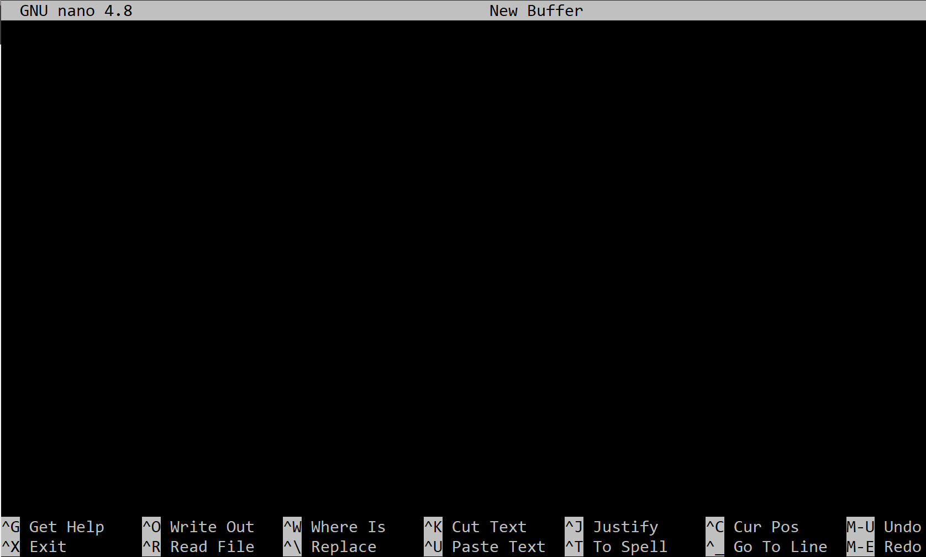
nano
nano is a (relatively new) visual display-presentation editor
Based on the editor pico
Interface much kinder for newcomers
Invoked as nano file
$ nano afilename

Slide 41
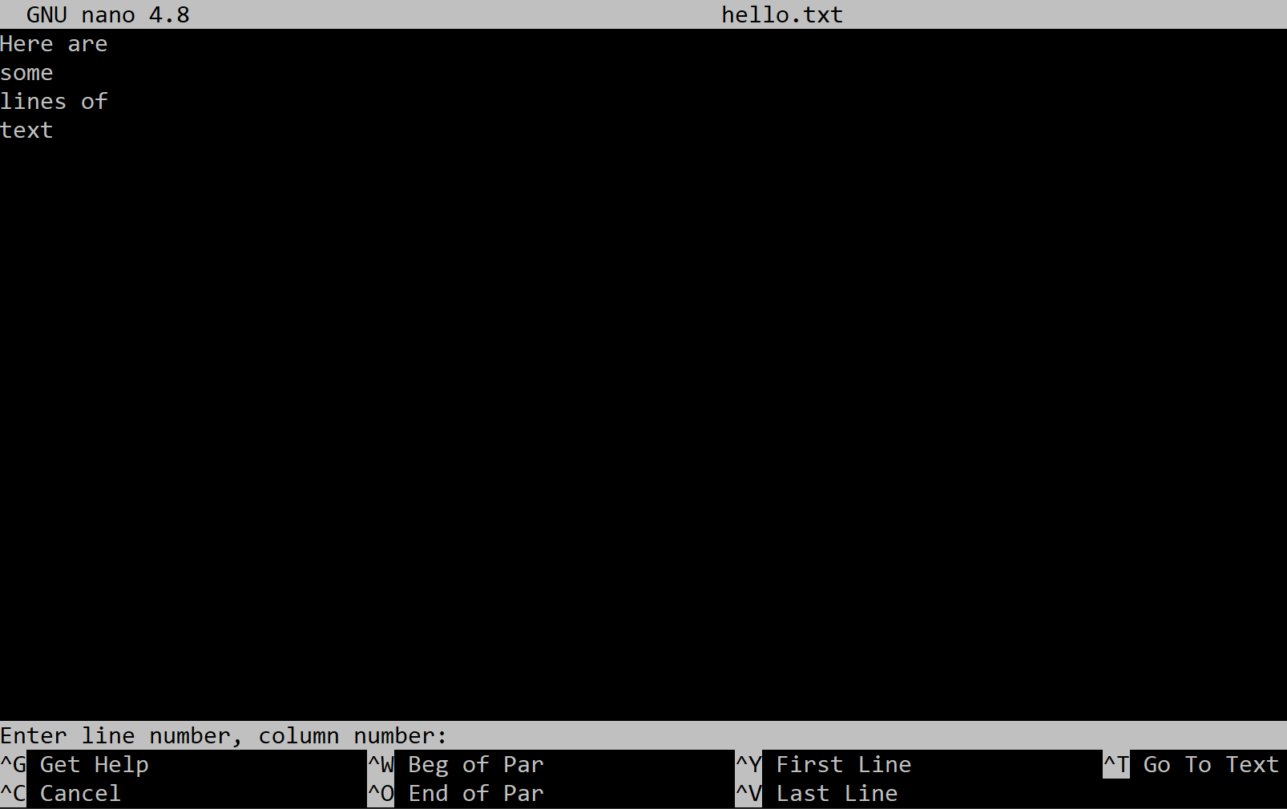
Navigating
<ctrl>c shows the current cursor position
<ctrl>a move to beginning of line
<ctrl>e move to end of line
<ctrl>\ move to beginning of file
<ctrl>/ move to end of file
<ctrl>_ (underscore) Goto line, char
<ctrl>W search

Slide 42
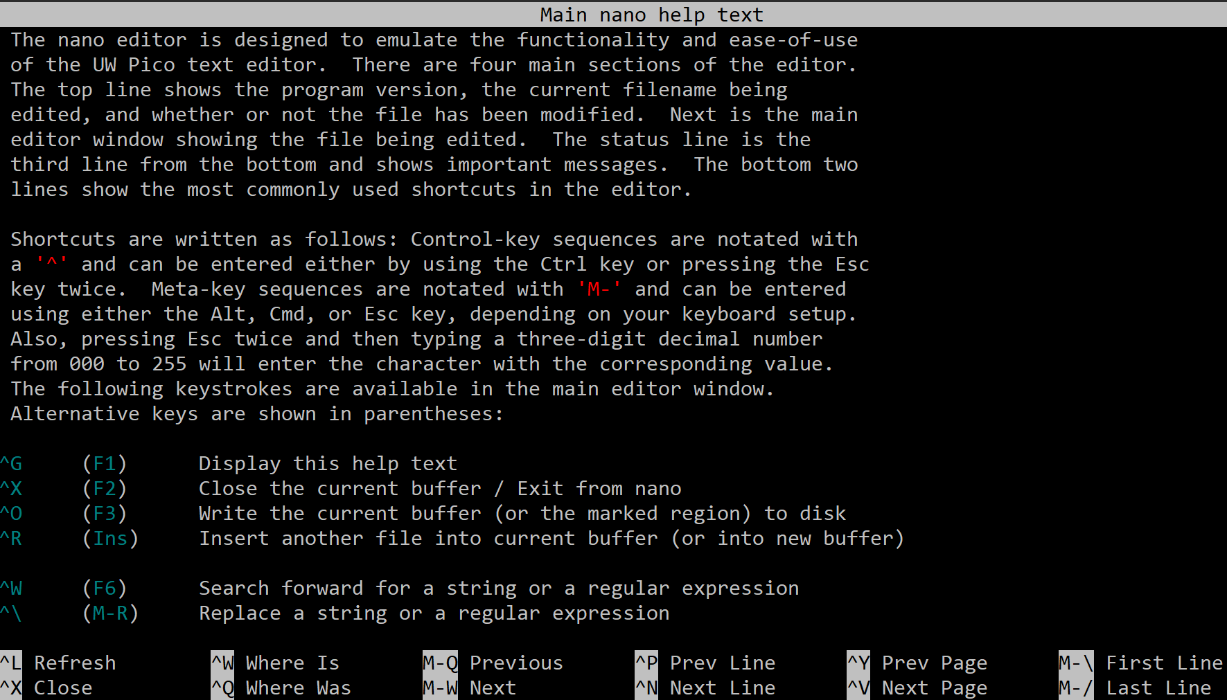
Copy cut paste
Shift and moving the cursor to select text
<alt>^ to copy
<ctrl>K to cut line
<ctrl>U to paste line

Slide 43
Saving and exit
<ctrl>s saves the file
<ctrl>o writes out the file (save as)
<ctrl>x initiates exit
Will immediately exit if no change since entering or last save
Otherwise asks (y/n) to save buffer (changes)
Optionally overriding the current file name (save as), or simply press <cr> (save)

Slide 44
Other editors
Open-source editors
emacs - part of the GNU utilities
kate - part of the KDE utilities (Linux)
X-window environments provide additional editors:
gedit – Gnome’s editor
xedit - Standard X editor
dtedit - UnixWare
edittool - Solaris
dtpad - CDE - Common Desktop Environment (AIX

Slide 45
Lab

Slide 46
Practical Exercise 4 – nano
In the accompanying Exercise Guide

Slide 47
Summary
vi is a screen editor. It operates in three modes:
Command mode – most characters are commands
Insert mode – where text can be entered into the file
Ex mode, with access to ex commands
It’s well worth learning vi.
Historically the only editor guaranteed to be present on every system
Some administrative tools transfer control to vi automatically
Several alternative editors exist.
Of those nano, kate, and pico are the most popular.
GUI environments provide additional editors.

